Slide 1
Lesson objective
PBiS focus
Achieve – stay on task
Learn – complete all work
HOMEWORK OUT!!
Title: Describing equations
Aim – be able to:
Write an equation from a description
Plan:
Review 2 step equations
Review operational words
Forming expressions
Need whiteboards

Slide 2

Whiteboards
3d + 9 = 27
5t – 4 = 11
9 + 3e = 18
$\frac{x}{3}+5=9$
12 – 3x = 0

Slide 3
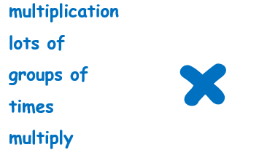
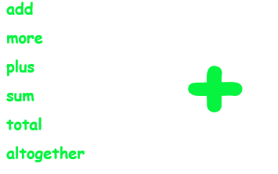
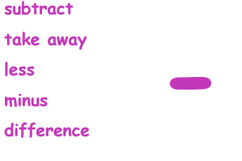
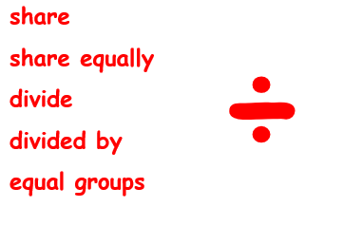
1
2
3
4

Slide 4

Forming expressions
Algebra is a form of maths ‘code’.
Sometimes rather than doing a calculation, we want to set a rule.
For instance, adding to a user’s score when they achieve something in a videogame.
Think of algebra as the ‘language’ of maths. The word algebra comes from the Arabic, al-jabr, meaning “the reunion of broken parts”.

Slide 5

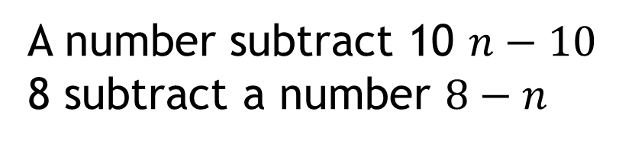
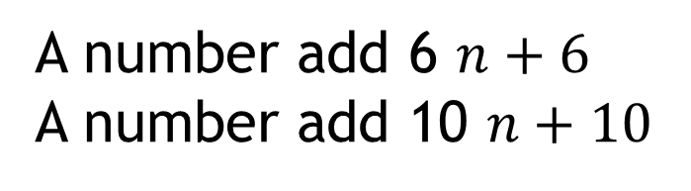
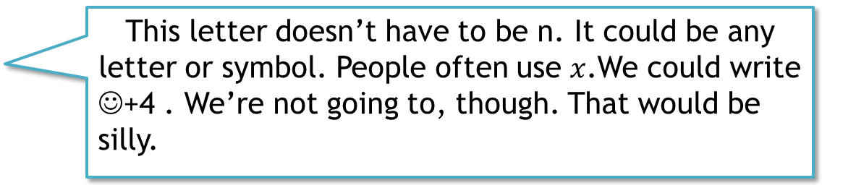
Forming expressions
‘Four more than a number’
$$n+4$$
This letter doesn’t have to be n. It could be any letter or symbol. People often use $x$.We could write
☺+4 . We’re not going to, though. That would be silly.
Write the following sentences algebraically.
A number add 6 $n+6$
A number add 10 $n+10$
A number subtract 10 $n−10$
8 subtract a number $8−n$
?
?
?
?

Slide 6
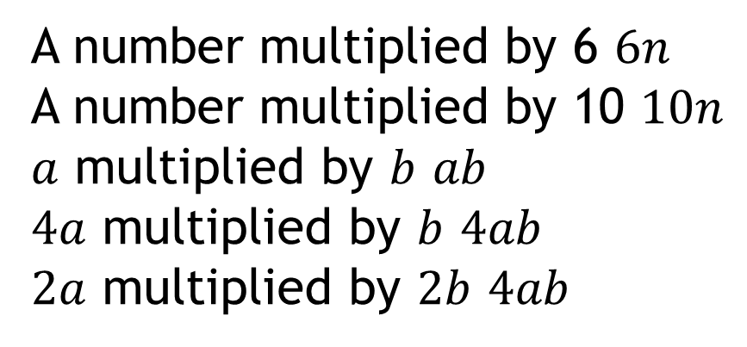
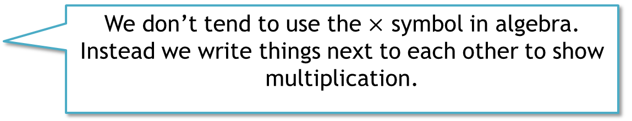
Forming expressions
‘Four lots of a number’
$$4n$$
We don’t tend to use the $×$ symbol in algebra. Instead we write things next to each other to show multiplication.
Write the following sentences algebraically.
A number multiplied by 6 $6n$
A number multiplied by 10 $10n$
$a$ multiplied by $b$ $ab$
$4a$ multiplied by $b$ $4ab$
$2a$ multiplied by $2b$ $4ab$
?
?
?
?
?

Slide 7

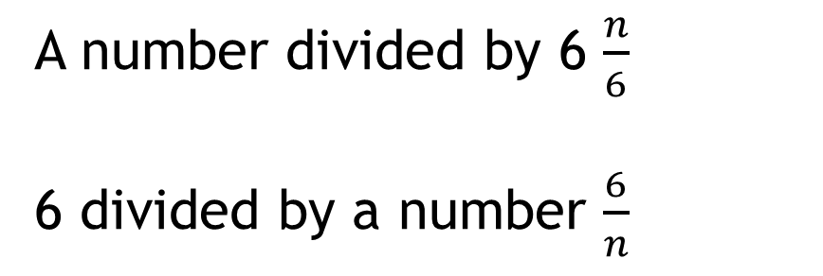
Forming expressions
‘A number divided by 5’
$$\frac{n}{5}$$
We tend not to use ÷ in expressions. We use fraction notation (writing a division as a fraction).
Write the following sentences algebraically.
A number divided by 6 $\frac{n}{6}$
6 divided by a number $\frac{6}{n}$
?
?

Slide 8
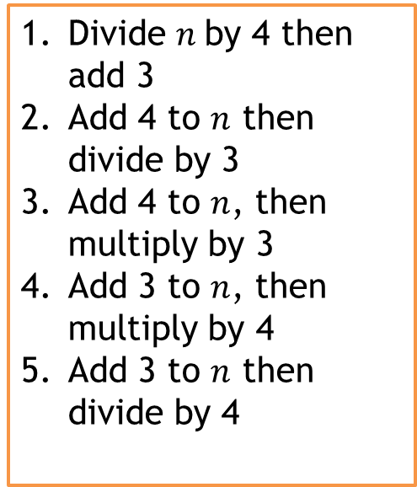


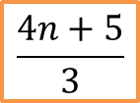
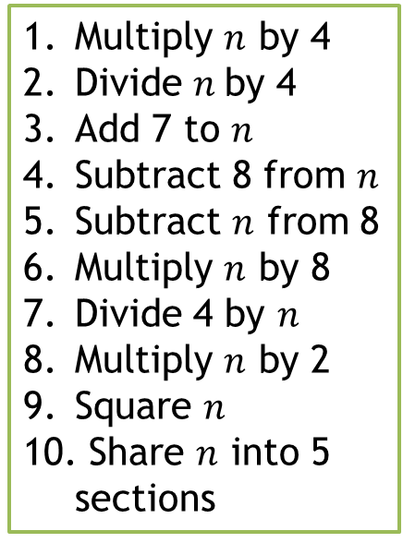



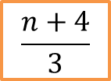
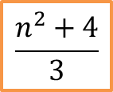

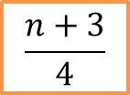

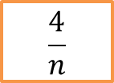
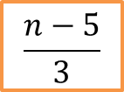


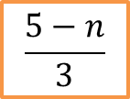



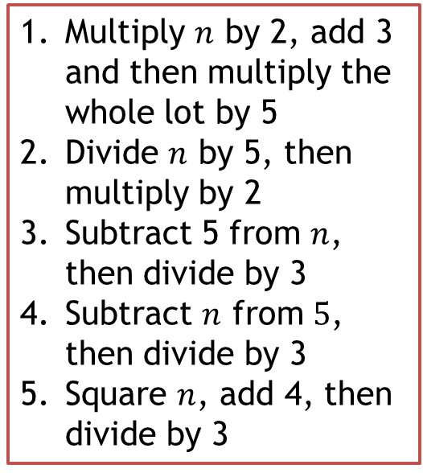


Forming expressions
Match the words to the algebra. Which piece of algebra code didn’t get matched? Write that code in English.
Multiply $n$ by 4
Divide $n$by 4
Add 7 to $n$
Subtract 8 from $n$
Subtract $n$ from 8
Multiply $n$ by 8
Divide 4 by $n$
Multiply $n$ by 2
Square $n$
Share $n$ into 5 sections
Divide $n$by 4 then add 3
Add 4 to $n$ then divide by 3
Add 4 to $n$, then multiply by 3
Add 3 to $n$, then multiply by 4
Add 3 to $n$ then divide by 4
Multiply $n$ by 2, add 3 and then multiply the whole lot by 5
Divide $n$ by 5, then multiply by 2
Subtract 5 from $n$, then divide by 3
Subtract $n$ from $5$, then divide by 3
Square $n$, add 4, then divide by 3
$$2n$$
$$5(2n+3)$$
$$3(n+4)$$
$$n −8$$
$$8n$$
$$\frac{n+4}{3}$$
$$\frac{n−5}{3}$$
$$\frac{n^{2}+4}{3}$$
$$2\left(\frac{n}{5}\right)$$
$$\frac{4n+5}{3}$$
$$\frac{4}{n}$$
$$\frac{n}{5}$$
$$\frac{n+3}{4}$$
$$\frac{5−n}{3}$$
$$\frac{n}{4}$$
$$8−n$$
$$n+7$$
$$4n$$
$$n^{2}$$
$$4(n+3)$$
$$\frac{n}{4}+3$$

Slide 9


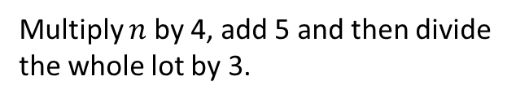

















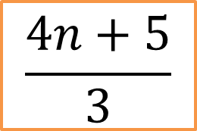
Forming expressions
Match the words to the algebra. Which piece of algebra code didn’t get matched?
$$4n$$
Divide $n$by 4 then add 3
Add 4 to $n$ then divide by 3
Add 4 to $n$, then multiply by 3
Add 3 to $n$, then multiply by 4
Add 3 to $n$ then divide by 4
Multiply $n$ by 4
Divide $n$by 4
Add 7 to $n$
Subtract 8 from $n$
Subtract $n$ from 8
Multiply $n$ by 8
Divide 4 by $n$
Multiply $n$ by 2
Square $n$
Share $n$ into 5 sections
$$\frac{n}{4}+3$$
Multiply $n$ by 2, add 3 and then multiply the whole lot by 5
Divide $n$ by 5, then multiply by 2
Subtract 5 from $n$, then divide by 3
Subtract $n$ from $5$, then divide by 3
Square $n$, add 4, then divide by 3
$$\frac{n}{4}$$
$$5(2n+3)$$
$$n+7$$
$$\frac{n+4}{3}$$
$$n−8$$
$$2\left(\frac{n}{5}\right)$$
$$8−n$$
$$3(n+4)$$
$$\frac{n−5}{3}$$
$$\frac{4}{n}$$
$$4(n+3)$$
$$2n$$
$$\frac{5−n}{3}$$
$$n^{2}$$
$$\frac{n+3}{4}$$
$$\frac{n^{2}+4}{3}$$
$$\frac{n}{5}$$
TPS how would you describe in words?
$$\frac{4n+5}{3}$$
Multiply $n$ by 4, add 5 and then divide the whole lot by 3.

Slide 10
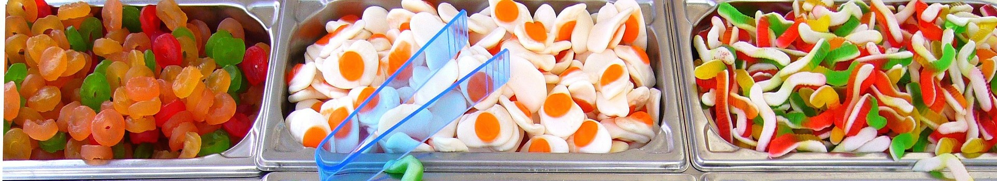
Forming expressions
Often you will be asked to take a ‘real life’ scenario and turn into mathematical code. For instance
Gummy rings cost 2c per gram, fried eggs cost 3c per gram, gummy snakes cost 4c per gram.
Find an expression for the total cost of $x$ grams of rings, $y$ grams of eggs and $z$ grams of snakes.
$$2x+3y+4z$$
Notice that the coefficent of $x$ (the number in front of $x$) stands for the price of the rings, not the number of them.

Slide 11


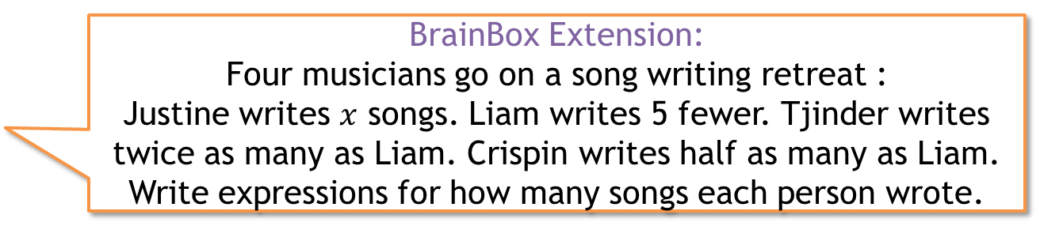
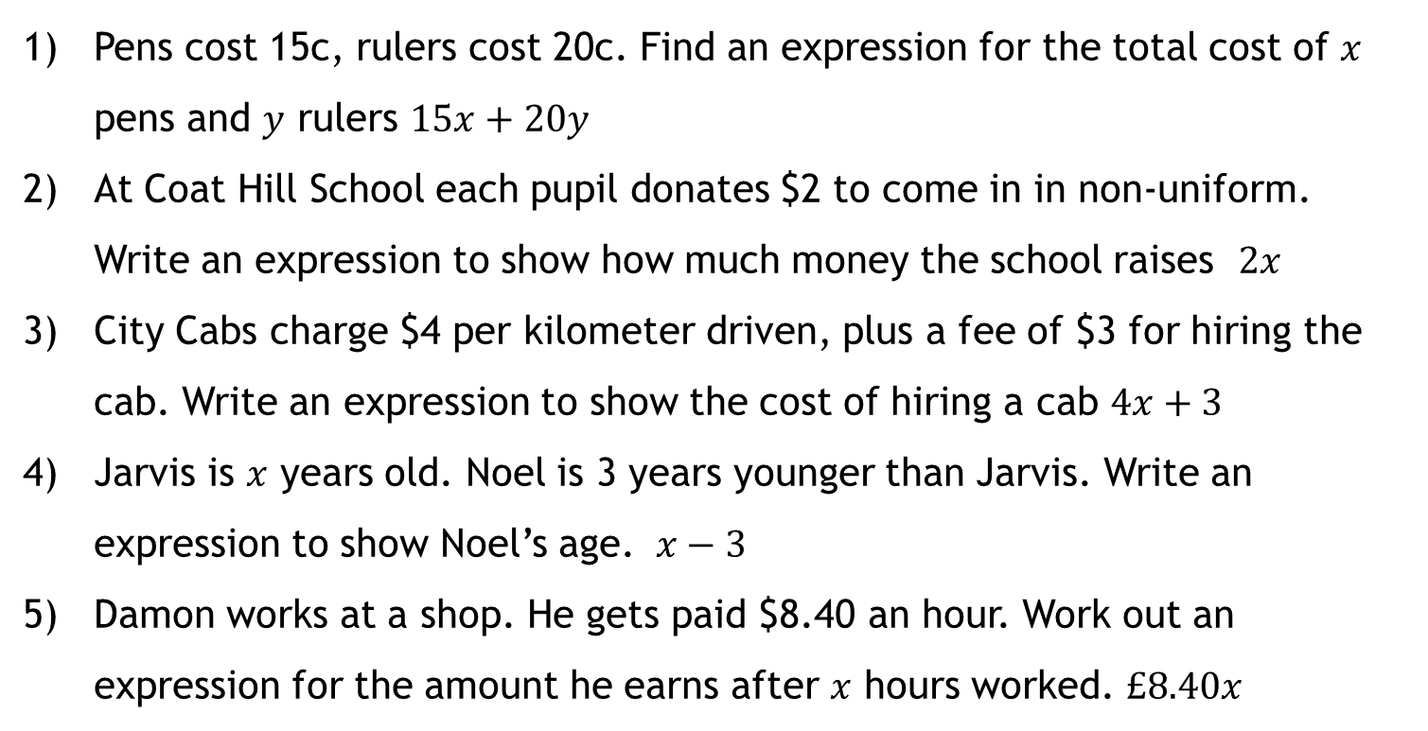
Forming expressions
Pens cost 15c, rulers cost 20c. Find an expression for the total cost of $x$ pens and $y$ rulers $15x+20y$
At Coat Hill School each pupil donates $2 to come in in non-uniform. Write an expression to show how much money the school raises $2x$
City Cabs charge $4 per kilometer driven, plus a fee of $3 for hiring the cab. Write an expression to show the cost of hiring a cab $4x+3$
Jarvis is $x$ years old. Noel is 3 years younger than Jarvis. Write an expression to show Noel’s age. $x−3$
Damon works at a shop. He gets paid $8.40 an hour. Work out an expression for the amount he earns after $x$ hours worked. $£8.40x$
?
?
?
?
?
Justine : $x$
Liam $x−5$
Tjinder $2(x−5)$
Crispin $\frac{x−5}{2}$
BrainBox Extension:
Four musicians go on a song writing retreat :
Justine writes $x$ songs. Liam writes 5 fewer. Tjinder writes twice as many as Liam. Crispin writes half as many as Liam. Write expressions for how many songs each person wrote.

Slide 12

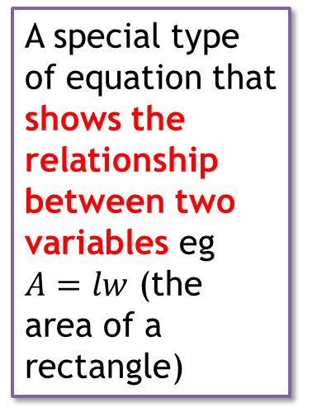
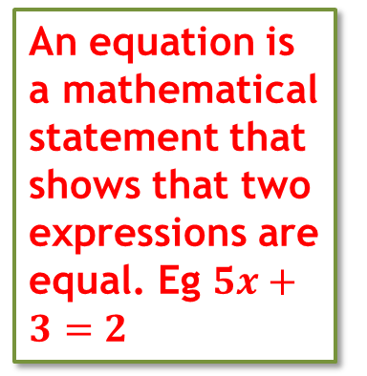
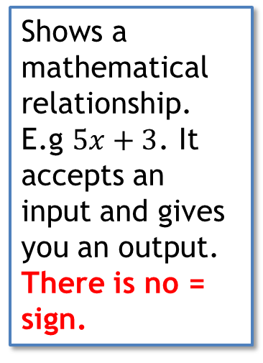
Forming expressions
Let’s talk about some of the language from the starter. I want to talk about the words EQUATION, EXPRESSION, FORMULA and IDENTITY. Often people mix them up, but they’re all different things.
EXPRESSION
EQUATION
FORMULA
Shows a mathematical relationship. E.g $5x+3$. It accepts an input and gives you an output. There is no = sign.
An equation is a mathematical statement that shows that two expressions are equal. Eg $5x+3=2$
A special type of equation that shows the relationship between two variables eg
$A=lw$ (the area of a rectangle)

Slide 13
Whiteboards
Expression
Formula
Equation

Slide 14
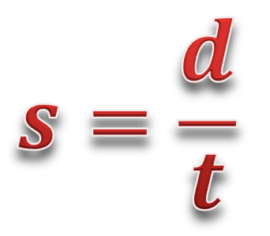





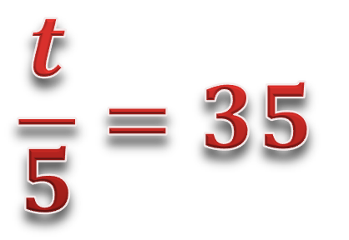
Forming expressions
Expression
or
Formula
Equation
$$2w+3v$$
$$4u+2=7$$
$$4u+3v$$
$$\frac{t}{5}=35$$
$$s=\frac{d}{t}$$
$$7.7+3u=18.2$$
$$9z+2=190$$

Slide 15
Forming expressions
5 QUICK QUESTIONS CHECK - whiteboards
Now it’s time to check your learning.
You’ll see five questions.
The questions have a 30 second timer
How many can you get right?
KEEP YOUR ANSWERS ON THE BOARD – NO ERASE

Slide 16

Forming expressions
Question 1
Write in words
$$5v+2u$$
Timer

Slide 17
Forming expressions
Question 2
Write an expression
5 lots of $x$, plus 7
Timer

Slide 18
Forming expressions
Question 3
Write an expression
9 added to$x$, divided by 5
Timer

Slide 19
Forming expressions
Question 4
Write an expression
$a$ multiplied by $b$, then divided by $c$
Timer

Slide 20
Forming expressions
Question 5
Write an expression
$a$ divided by $b$, then add 6
Timer

Slide 21

Forming expressions
Your answers:
5 lots of $v$, added to 2 lots of $u$
$5x+7$
$\frac{9+x}{5}$
$\frac{ab}{c}$
$\frac{a}{b}+6$

Slide 22


Problem Solving Question
Work out an expression for the perimeter
$$x$$
$$5x$$

Slide 23
The solution
$$24x$$
Complete the worksheets provided:
“Why doesn’t an elephant smoke?” DD-42 CF
“What kind of case would a lawyer have if he slipped and hurt himself at the pool?” MOM 2.4/24

